Slide 1
Chapter 19: Distributed Databases
Heterogeneous and Homogeneous Databases
Distributed Data Storage
Distributed Transactions
Commit Protocols
Concurrency Control in Distributed Databases
Availability
Distributed Query Processing
Heterogeneous Distributed Databases
Directory Systems

Slide 2
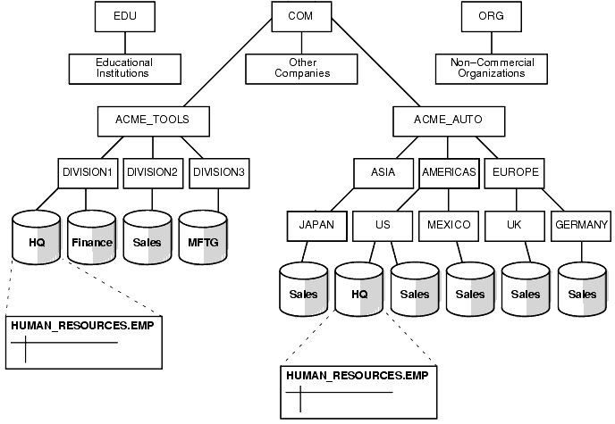
Distributed Database System
A distributed database system consists of loosely coupled sites that share no physical component
Database systems that run on each site are independent of each other
Transactions may access data at one or more sites

Slide 3
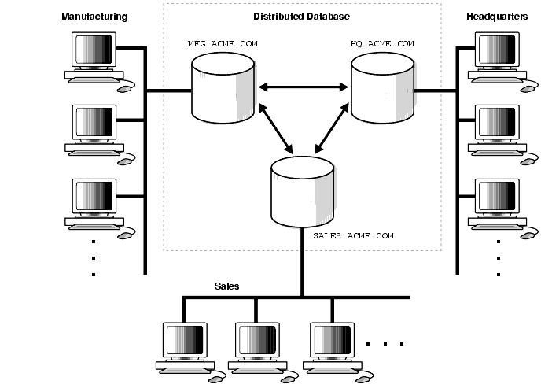
Homogeneous Distributed Databases
In a homogeneous distributed database
  All sites have identical software
  Are aware of each other and agree to cooperate in processing user requests.
  Each site surrenders part of its autonomy in terms of right to change schemas or software
  Appears to user as a single system

Slide 4
Homogeneous Distributed Databases
In a heterogeneous distributed database
  Different sites may use different schemas and software
    Difference in schema is a major problem for query processing
    Difference in software is a major problem for transaction processing
  Sites may not be aware of each other and may provide only
  limited facilities for cooperation in transaction processing

Slide 5
Architectural Models
Some of the common architectural models are −
      Client - Server Architecture for DDBMS
      Collaborating server architecture
      Middleware architecture

Slide 6
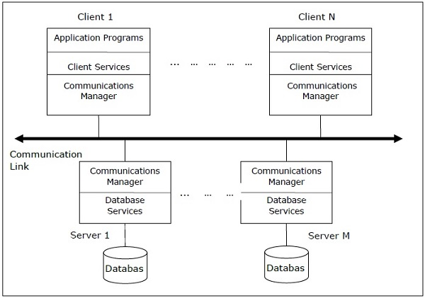
Client - Server Architecture for DDBMS
This is a two-level architecture where the functionality is divided into servers and clients. The server functions primarily encompass data management, query processing, optimization and transaction management. Client functions include mainly user interface. However, they have some functions like consistency checking and transaction management.
The two different client - server architecture are −
  Single Server Multiple Client
  Multiple Server Multiple Client (shown in the following diagram)

Slide 7
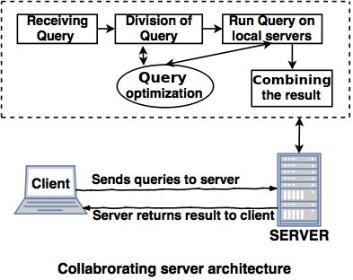
Collaborating server architecture
Collaborating server architecture is designed to run a single query on multiple servers.
Servers break single query into multiple small queries and the result is sent to the client.
Collaborating server architecture has a collection of database servers. Each server is
capable for executing the current transactions across the databases.

Slide 8
Middleware architecture
Middleware architectures are designed in such a way that single query is
executed on multiple servers.
This system needs only one server which is capable of managing queries and
transactions from multiple servers.
Middleware architecture uses local servers to handle local queries and
transactions.
The software's are used for execution of queries and transactions across one or
more independent database servers, this type of software is called as middleware.

Slide 9
Distributed Data Storage
Assume relational data model
Replication
  System maintains multiple copies of data, stored in different sites, for faster retrieval and fault tolerance.
Fragmentation
  Relation is partitioned into several fragments stored in distinct sites
Replication and fragmentation can be combined
  Relation is partitioned into several fragments: system maintains several identical replicas of each such fragment.

Slide 10
Data Replication
A relation or fragment of a relation is replicated if it is stored redundantly in two or more sites.
Full replication of a relation is the case where the relation is stored at all sites.
Fully redundant databases are those in which every site contains a copy of the entire database.

Slide 11
Data Replication (Cont.)
Advantages of Replication
  Availability: failure of site containing relation r does not result in unavailability of r is replicas exist.
  Parallelism: queries on r may be processed by several nodes in parallel.
  Reduced data transfer: relation r is available locally at each site containing a replica of r.
Disadvantages of Replication
  Increased cost of updates: each replica of relation r must be updated.
  Increased complexity of concurrency control: concurrent updates to distinct replicas may lead to inconsistent data unless special concurrency control mechanisms are implemented.
    One solution: choose one copy as primary copy and apply concurrency control operations on primary copy

Slide 12
Data Fragmentation
Division of relation r into fragments r₁, r₂, …, r_{n} which contain sufficient information to reconstruct relation r.
Horizontal fragmentation: each tuple of r is assigned to one or more fragments
Vertical fragmentation: the schema for relation r is split into several smaller schemas
  All schemas must contain a common candidate key (or superkey) to ensure lossless join property.
  A special attribute, the tuple-id attribute may be added to each schema to serve as a candidate key.

Slide 13
Horizontal Fragmentation of account Relation
branch_name
account_number
balance
Hillside
Hillside
Hillside
A-305
A-226
A-155
500
336
62
account₁ = σ_{branch_name=“Hillside”} (account )
branch_name
account_number
balance
Valleyview
Valleyview
Valleyview
Valleyview
A-177
A-402
A-408
A-639
205
10000
1123
750
account₂ = σ_{branch_name=“Valleyview”} (account )

Slide 14
Vertical Fragmentation of employee_info Relation
branch_name
customer_name
tuple_id
Hillside
Hillside
Valleyview
Valleyview
Hillside
Valleyview
Valleyview
Lowman
Camp
Camp
Kahn
Kahn
Kahn
Green
1
2
3
4
5
6
7
deposit₁ = Πbranch_name, customer_name, tuple_id (employee_info )
account_number
balance
tuple_id
A-305
A-226
A-177
A-402
A-155
A-408
A-639
500
336
205
10000
62
1123
750
1
2
3
4
5
6
7
deposit₂ = Πaccount_number, balance, tuple_id (employee_info )

Slide 15
Advantages of Fragmentation
Horizontal:
  allows parallel processing on fragments of a relation
  allows a relation to be split so that tuples are located where they are most frequently accessed
Vertical:
  allows tuples to be split so that each part of the tuple is stored where it is most frequently accessed
  tuple-id attribute allows efficient joining of vertical fragments
  allows parallel processing on a relation
Vertical and horizontal fragmentation can be mixed.
  Fragments may be successively fragmented to an arbitrary depth.

Slide 16
Data Transparency
Data transparency: Degree to which system user may remain unaware of the details of how and where the data items are stored in a distributed system
Consider transparency issues in relation to:
  Fragmentation transparency
  Replication transparency
  Location transparency

Slide 17
Naming of Data Items - Criteria
1. Every data item must have a system-wide unique name.
2. It should be possible to find the location of data items efficiently.
3. It should be possible to change the location of data items transparently.
4. Each site should be able to create new data items autonomously.

Slide 18
Centralized Scheme - Name Server
Structure:
  name server assigns all names
  each site maintains a record of local data items
  sites ask name server to locate non-local data items
Advantages:
  satisfies naming criteria 1-3
Disadvantages:
  does not satisfy naming criterion 4
  name server is a potential performance bottleneck
  name server is a single point of failure

Slide 19
Use of Aliases
Alternative to centralized scheme: each site prefixes its own site identifier to any name that it generates i.e., site 17.account.
  Fulfills having a unique identifier, and avoids problems associated with central control.
  However, fails to achieve network transparency.
Solution: Create a set of aliases for data items; Store the mapping of aliases to the real names at each site.
The user can be unaware of the physical location of a data item, and is unaffected if the data item is moved from one site to another.

Slide 20
Distributed Transactions and 2 Phase Commit

Slide 21
Distributed Transactions
Transaction may access data at several sites.
Each site has a local transaction manager responsible for:
  Maintaining a log for recovery purposes
  Participating in coordinating the concurrent execution of the transactions executing at that site.
Each site has a transaction coordinator, which is responsible for:
  Starting the execution of transactions that originate at the site.
  Distributing subtransactions at appropriate sites for execution.
  Coordinating the termination of each transaction that originates at the site, which may result in the transaction being committed at all sites or aborted at all sites.

Slide 22
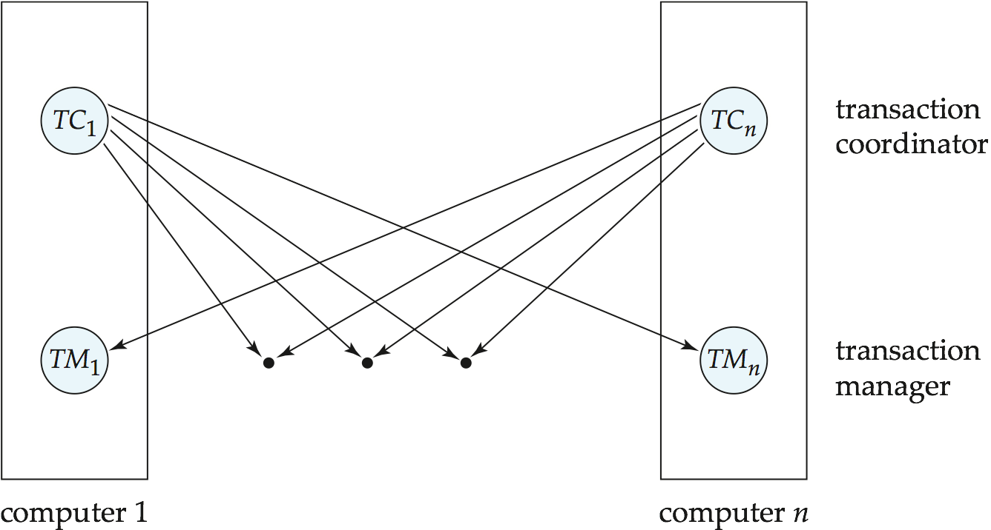
Transaction System Architecture

Slide 23
System Failure Modes
Failures unique to distributed systems:
  Failure of a site.
  Loss of messages
    Handled by network transmission control protocols such as TCP-IP
  Failure of a communication link
    Handled by network protocols, by routing messages via alternative links
  Network partition
    A network is said to be partitioned when it has been split into two or more subsystems that lack any connection between them
      Note: a subsystem may consist of a single node
Network partitioning and site failures are generally indistinguishable.

Slide 24
Commit Protocols
Commit protocols are used to ensure atomicity across sites
  a transaction which executes at multiple sites must either be committed at all the sites, or aborted at all the sites.
  not acceptable to have a transaction committed at one site and aborted at another
The two-phase commit (2PC) protocol is widely used
The three-phase commit (3PC) protocol is more complicated and more expensive, but avoids some drawbacks of two-phase commit protocol. This protocol is not used in practice.

Slide 25
Two Phase Commit Protocol (2PC)
Assumes fail-stop model – failed sites simply stop working, and do not cause any other harm, such as sending incorrect messages to other sites.
Execution of the protocol is initiated by the coordinator after the last step of the transaction has been reached.
The protocol involves all the local sites at which the transaction executed
Let T be a transaction initiated at site S_{i}, and let the transaction coordinator at S_{i} be C_{i}

Slide 26
Phase 1: Obtaining a Decision
Coordinator asks all participants to prepare to commit transaction T_{i}.
  C_{i} adds the records <prepare T> to the log and forces log to stable storage
  sends prepare T messages to all sites at which T executed
Upon receiving message, transaction manager at site determines if it can commit the transaction
  if not, add a record <no T> to the log and send abort T message to C_{i}
  if the transaction can be committed, then:
  add the record <ready T> to the log
  force all records for T to stable storage
  send ready T message to C_{i}

Slide 27
Phase 2: Recording the Decision
T can be committed of C_{i} received a ready T message from all the participating sites: otherwise T must be aborted.
Coordinator adds a decision record, <commit T> or <abort T>, to the log and forces record onto stable storage. Once the record stable storage it is irrevocable (even if failures occur)
Coordinator sends a message to each participant informing it of the decision (commit or abort)
Participants take appropriate action locally.

Slide 28
Handling of Failures - Site Failure
When site S_{i} recovers, it examines its log to determine the fate of
transactions active at the time of the failure.
Log contain <commit T> record: txn had completed, nothing to be done
Log contains <abort T> record: txn had completed, nothing to be done
Log contains <ready T> record: site must consult C_{i} to determine the fate of T.
  If T committed, redo (T); write <commit T> record
  If T aborted, undo (T)
The log contains no log records concerning T:
  Implies that S_{k} failed before responding to the prepare T message from C_{i}
  since the failure of S_{k} precludes the sending of such a response, coordinator C₁ must abort T
  S_{k} must execute undo (T)

Slide 29
Handling of Failures- Coordinator Failure
If coordinator fails while the commit protocol for T is executing then participating sites must decide on T’s fate:
  If an active site contains a <commit T> record in its log, then T must be committed.
  If an active site contains an <abort T> record in its log, then T must be aborted.
  If some active participating site does not contain a <ready T> record in its log, then the failed coordinator C_{i} cannot have decided to commit T.
    Can therefore abort T; however, such a site must reject any subsequent <prepare T> message from C_{i}
  If none of the above cases holds, then all active sites must have a <ready T> record in their logs, but no additional control records (such as <abort T> of <commit T>).
    In this case active sites must wait for C_{i} to recover, to find decision.
Blocking problem: active sites may have to wait for failed coordinator to recover.

Slide 30
Handling of Failures - Network Partition
If the coordinator and all its participants remain in one partition, the failure has no effect on the commit protocol.
If the coordinator and its participants belong to several partitions:
  Sites that are not in the partition containing the coordinator think the coordinator has failed, and execute the protocol to deal with failure of the coordinator.
    No harm results, but sites may still have to wait for decision from coordinator.
The coordinator and the sites are in the same partition as the coordinator think that the sites in the other partition have failed, and follow the usual commit protocol.
    Again, no harm results

Slide 31
Recovery and Concurrency Control
In-doubt transactions have a <ready T>, but neither a
<commit T>, nor an <abort T> log record.
The recovering site must determine the commit-abort status of such transactions by contacting other sites; this can slow and potentially block recovery.
Recovery algorithms can note lock information in the log.
  Instead of <ready T>, write out <ready T, L> L = list of locks held by T when the log is written (read locks can be omitted).
  For every in-doubt transaction T, all the locks noted in the
  <ready T, L> log record are reacquired.
After lock reacquisition, transaction processing can resume; the commit or rollback of in-doubt transactions is performed concurrently with the execution of new transactions.

Slide 32
Three Phase Commit (3PC)
Assumptions:
  No network partitioning
  At any point, at least one site must be up.
  At most K sites (participants as well as coordinator) can fail
Phase 1: Obtaining Preliminary Decision: Identical to 2PC Phase 1.
  Every site is ready to commit if instructed to do so
Phase 2 of 2PC is split into 2 phases, Phase 2 and Phase 3 of 3PC
  In phase 2 coordinator makes a decision as in 2PC (called the pre-commit decision) and records it in multiple (at least K) sites
  In phase 3, coordinator sends commit/abort message to all participating sites,
Under 3PC, knowledge of pre-commit decision can be used to commit despite coordinator failure
  Avoids blocking problem as long as < K sites fail
Drawbacks:
  higher overheads
  assumptions may not be satisfied in practice

Slide 33
Alternative Models of Transaction Processing
Notion of a single transaction spanning multiple sites is inappropriate for many applications
  E.g. transaction crossing an organizational boundary
  No organization would like to permit an externally initiated transaction to block local transactions for an indeterminate period
Alternative models carry out transactions by sending messages
  Code to handle messages must be carefully designed to ensure atomicity and durability properties for updates
    Isolation cannot be guaranteed, in that intermediate stages are visible, but code must ensure no inconsistent states result due to concurrency
  Persistent messaging systems are systems that provide transactional properties to messages
    Messages are guaranteed to be delivered exactly once
    Will discuss implementation techniques later

Slide 34
Alternative Models (Cont.)
Motivating example: funds transfer between two banks
  Two phase commit would have the potential to block updates on the accounts involved in funds transfer
  Alternative solution:
    Debit money from source account and send a message to other site
    Site receives message and credits destination account
  Messaging has long been used for distributed transactions (even before computers were invented!)
Atomicity issue
  once transaction sending a message is committed, message must guaranteed to be delivered
    Guarantee as long as destination site is up and reachable, code to handle undeliverable messages must also be available
      e.g. credit money back to source account.
  If sending transaction aborts, message must not be sent

Slide 35
Error Conditions with Persistent Messaging
Code to handle messages has to take care of variety of failure situations (even assuming guaranteed message delivery)
  E.g. if destination account does not exist, failure message must be sent back to source site
  When failure message is received from destination site, or destination site itself does not exist, money must be deposited back in source account
    Problem if source account has been closed
      get humans to take care of problem
User code executing transaction processing using 2PC does not have to deal with such failures
There are many situations where extra effort of error handling is worth the benefit of absence of blocking
  E.g. pretty much all transactions across organizations

Slide 36
Persistent Messaging and Workflows
Workflows provide a general model of transactional processing involving multiple sites and possibly human processing of certain steps
  E.g. when a bank receives a loan application, it may need to
    Contact external credit-checking agencies
    Get approvals of one or more managers
  and then respond to the loan application
  We study workflows in Chapter 25
  Persistent messaging forms the underlying infrastructure for workflows in a distributed environment

Slide 37
Implementation of Persistent Messaging
Sending site protocol.
  When a transaction wishes to send a persistent message, it writes a record containing the message in a special relation messages_to_send; the message is given a unique message identifier.
  A message delivery process monitors the relation, and when a new message is found, it sends the message to its destination.
  The message delivery process deletes a message from the relation only after it receives an acknowledgment from the destination site.
    If it receives no acknowledgement from the destination site, after some time it sends the message again. It repeats this until an acknowledgment is received.
    If after some period of time, that the message is undeliverable, exception handling code provided by the application is invoked to deal with the failure.
Writing the message to a relation and processing it only after the transaction commits ensures that the message will be delivered if and only if the transaction commits.

Slide 38
Implementation of Persistent Messaging (Cont.)
Receiving site protocol.
  When a site receives a persistent message, it runs a transaction that adds the message to a received_messages relation
    provided message identifier is not already present in the relation
  After the transaction commits, or if the message was already present in the relation, the receiving site sends an acknowledgment back to the sending site.
    Note that sending the acknowledgment before the transaction commits is not safe, since a system failure may then result in loss of the message.
  In many messaging systems, it is possible for messages to get delayed arbitrarily, although such delays are very unlikely.
    Each message is given a timestamp, and if the timestamp of a received message is older than some cutoff, the message is discarded.
    All messages recorded in the received messages relation that are older than the cutoff can be deleted.

Slide 39
Concurrency Control

Slide 40
Concurrency Control
Modify concurrency control schemes for use in distributed environment.
We assume that each site participates in the execution of a commit protocol to ensure global transaction automicity.
We assume all replicas of any item are updated
  Will see how to relax this in case of site failures later

Slide 41
Single-Lock-Manager Approach
System maintains a single lock manager that resides in a single chosen site, say S_{i}
When a transaction needs to lock a data item, it sends a lock request to S_{i} and lock manager determines whether the lock can be granted immediately
  If yes, lock manager sends a message to the site which initiated the request
  If no, request is delayed until it can be granted, at which time a message is sent to the initiating site

Slide 42
Single-Lock-Manager Approach (Cont.)
The transaction can read the data item from any one of the sites at which a replica of the data item resides.
Writes must be performed on all replicas of a data item
Advantages of scheme:
  Simple implementation
  Simple deadlock handling
Disadvantages of scheme are:
  Bottleneck: lock manager site becomes a bottleneck
  Vulnerability: system is vulnerable to lock manager site failure.

Slide 43
Distributed Lock Manager
In this approach, functionality of locking is implemented by lock managers at each site
  Lock managers control access to local data items
    But special protocols may be used for replicas
Advantage: work is distributed and can be made robust to failures
Disadvantage: deadlock detection is more complicated
  Lock managers cooperate for deadlock detection
    More on this later
Several variants of this approach
  Primary copy
  Majority protocol
  Biased protocol
  Quorum consensus

Slide 44
Primary Copy
Choose one replica of data item to be the primary copy.
  Site containing the replica is called the primary site for that data item
  Different data items can have different primary sites
When a transaction needs to lock a data item Q, it requests a lock at the primary site of Q.
  Implicitly gets lock on all replicas of the data item
Benefit
  Concurrency control for replicated data handled similarly to unreplicated data - simple implementation.
Drawback
  If the primary site of Q fails, Q is inaccessible even though other sites containing a replica may be accessible.

Slide 45
Majority Protocol
Local lock manager at each site administers lock and unlock requests for data items stored at that site.
When a transaction wishes to lock an unreplicated data item Q residing at site S_{i}, a message is sent to S_{i} ‘s lock manager.
  If Q is locked in an incompatible mode, then the request is delayed until it can be granted.
  When the lock request can be granted, the lock manager sends a message back to the initiator indicating that the lock request has been granted.

Slide 46
Majority Protocol (Cont.)
In case of replicated data
  If Q is replicated at n sites, then a lock request message must be sent to more than half of the n sites in which Q is stored.
  The transaction does not operate on Q until it has obtained a lock on a majority of the replicas of Q.
  When writing the data item, transaction performs writes on all replicas.
Benefit
  Can be used even when some sites are unavailable
    details on how handle writes in the presence of site failure later
Drawback
  Requires 2(n/2 + 1) messages for handling lock requests, and (n/2 + 1) messages for handling unlock requests.
  Potential for deadlock even with single item - e.g., each of 3 transactions may have locks on 1/3rd of the replicas of a data.

Slide 47
Biased Protocol
Local lock manager at each site as in majority protocol, however, requests for shared locks are handled differently than requests for exclusive locks.
Shared locks. When a transaction needs to lock data item Q, it simply requests a lock on Q from the lock manager at one site containing a replica of Q.
Exclusive locks. When transaction needs to lock data item Q, it requests a lock on Q from the lock manager at all sites containing a replica of Q.
Advantage - imposes less overhead on read operations.
Disadvantage - additional overhead on writes

Slide 48
Quorum Consensus Protocol
A generalization of both majority and biased protocols
Each site is assigned a weight.
  Let S be the total of all site weights
Choose two values read quorum Q_{r} and write quorum Q_{w}
  Such that Q_{r} + Q_{w} > S and 2 * Q_{w} > S
  Quorums can be chosen (and S computed) separately for each item
Each read must lock enough replicas that the sum of the site weights is >= Q_{r}
Each write must lock enough replicas that the sum of the site weights is >= Q_{w}
For now we assume all replicas are written
  Extensions to allow some sites to be unavailable described later

Slide 49
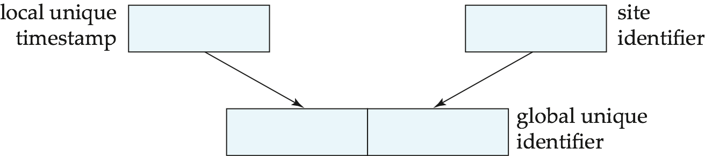
Timestamping
Timestamp based concurrency-control protocols can be used in distributed systems
Each transaction must be given a unique timestamp
Main problem: how to generate a timestamp in a distributed fashion
  Each site generates a unique local timestamp using either a logical counter or the local clock.
  Global unique timestamp is obtained by concatenating the unique local timestamp with the unique identifier.

Slide 50
Timestamping (Cont.)
A site with a slow clock will assign smaller timestamps
  Still logically correct: serializability not affected
  But: “disadvantages” transactions
To fix this problem
  Define within each site S_{i} a logical clock (LC_{i}), which generates the unique local timestamp
  Require that S_{i} advance its logical clock whenever a request is received from a transaction Ti with timestamp < x,y> and x is greater that the current value of LC_{i}.
  In this case, site S_{i} advances its logical clock to the value x + 1.

Slide 51
Replication with Weak Consistency
Many commercial databases support replication of data with weak degrees of consistency (I.e., without a guarantee of serializabiliy)
E.g.: master-slave replication: updates are performed at a single “master” site, and propagated to “slave” sites.
  Propagation is not part of the update transaction: its is decoupled
    May be immediately after transaction commits
    May be periodic
  Data may only be read at slave sites, not updated
    No need to obtain locks at any remote site
  Particularly useful for distributing information
    E.g. from central office to branch-office
  Also useful for running read-only queries offline from the main database

Slide 52
Replication with Weak Consistency (Cont.)
Replicas should see a transaction-consistent snapshot of the database
  That is, a state of the database reflecting all effects of all transactions up to some point in the serialization order, and no effects of any later transactions.
E.g. Oracle provides a create snapshot statement to create a snapshot of a relation or a set of relations at a remote site
  snapshot refresh either by recomputation or by incremental update
  Automatic refresh (continuous or periodic) or manual refresh

Slide 53
Multimaster and Lazy Replication
With multimaster replication (also called update-anywhere replication) updates are permitted at any replica, and are automatically propagated to all replicas
  Basic model in distributed databases, where transactions are unaware of the details of replication, and database system propagates updates as part of the same transaction
    Coupled with 2 phase commit
Many systems support lazy propagation where updates are transmitted after transaction commits
  Allows updates to occur even if some sites are disconnected from the network, but at the cost of consistency

Slide 54
Deadlock Handling
Consider the following two transactions and history, with item X and transaction T₁ at site 1, and item Y and transaction T₂ at site 2:
T₁: write (X)
write (Y)
T₂: write (Y)
write (X)
X-lock on X
write (X)
X-lock on Y
write (Y)
wait for X-lock on X
Wait for X-lock on Y
Result: deadlock which cannot be detected locally at either site

Slide 55
Centralized Approach
A global wait-for graph is constructed and maintained in a single site; the deadlock-detection coordinator
  Real graph: Real, but unknown, state of the system.
  Constructed graph:Approximation generated by the controller during the execution of its algorithm .
the global wait-for graph can be constructed when:
  a new edge is inserted in or removed from one of the local wait-for graphs.
  a number of changes have occurred in a local wait-for graph.
  the coordinator needs to invoke cycle-detection.
If the coordinator finds a cycle, it selects a victim and notifies all sites. The sites roll back the victim transaction.

Slide 56
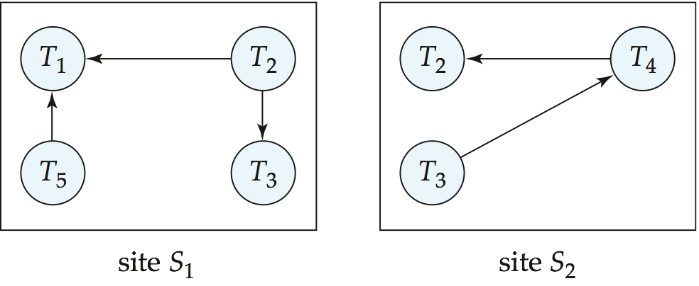
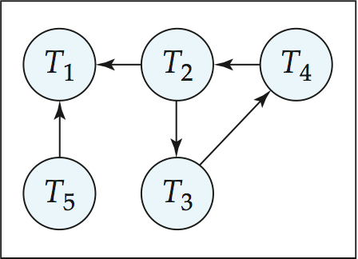
Local and Global Wait-For Graphs
Local
Global

Slide 57
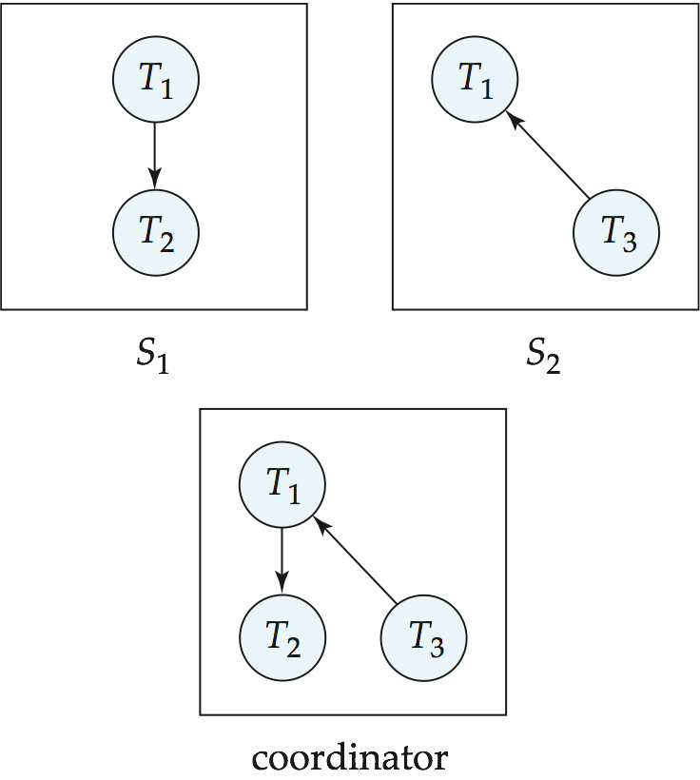
Example Wait-For Graph for False Cycles
Initial state:

Slide 58
False Cycles (Cont.)
Suppose that starting from the state shown in figure,
1. T₂ releases resources at S₁
    resulting in a message remove T₁ → T₂ message from the Transaction Manager at site S₁ to the coordinator)
2. And then T₂ requests a resource held by T₃ at site S₂
    resulting in a message insert T₂ → T₃ from S₂ to the coordinator
Suppose further that the insert message reaches before the delete message
  this can happen due to network delays
The coordinator would then find a false cycle
T₁ → T₂ → T₃ → T₁
The false cycle above never existed in reality.
False cycles cannot occur if two-phase locking is used.

Slide 59
Unnecessary Rollbacks
Unnecessary rollbacks may result when deadlock has indeed occurred and a victim has been picked, and meanwhile one of the transactions was aborted for reasons unrelated to the deadlock.
Unnecessary rollbacks can result from false cycles in the global wait-for graph; however, likelihood of false cycles is low.

Slide 60
Availability

Slide 61
Availability
High availability: time for which system is not fully usable should be extremely low (e.g. 99.99% availability)
Robustness: ability of system to function spite of failures of components
Failures are more likely in large distributed systems
To be robust, a distributed system must
  Detect failures
  Reconfigure the system so computation may continue
  Recovery/reintegration when a site or link is repaired
Failure detection: distinguishing link failure from site failure is hard
  (partial) solution: have multiple links, multiple link failure is likely a site failure

Slide 62
Reconfiguration
Reconfiguration:
  Abort all transactions that were active at a failed site
    Making them wait could interfere with other transactions since they may hold locks on other sites
    However, in case only some replicas of a data item failed, it may be possible to continue transactions that had accessed data at a failed site (more on this later)
  If replicated data items were at failed site, update system catalog to remove them from the list of replicas.
    This should be reversed when failed site recovers, but additional care needs to be taken to bring values up to date
  If a failed site was a central server for some subsystem, an election must be held to determine the new server
    E.g. name server, concurrency coordinator, global deadlock detector

Slide 63
Reconfiguration (Cont.)
Since network partition may not be distinguishable from site failure, the following situations must be avoided
  Two ore more central servers elected in distinct partitions
  More than one partition updates a replicated data item
Updates must be able to continue even if some sites are down
Solution: majority based approach
  Alternative of “read one write all available” is tantalizing but causes problems

Slide 64
Majority-Based Approach
The majority protocol for distributed concurrency control can be modified to work even if some sites are unavailable
  Each replica of each item has a version number which is updated when the replica is updated, as outlined below
  A lock request is sent to at least ½ the sites at which item replicas are stored and operation continues only when a lock is obtained on a majority of the sites
  Read operations look at all replicas locked, and read the value from the replica with largest version number
    May write this value and version number back to replicas with lower version numbers (no need to obtain locks on all replicas for this task)

Slide 65
Majority-Based Approach
Majority protocol (Cont.)
  Write operations
    find highest version number like reads, and set new version number to old highest version + 1
    Writes are then performed on all locked replicas and version number on these replicas is set to new version number
  Failures (network and site) cause no problems as long as
    Sites at commit contain a majority of replicas of any updated data items
    During reads a majority of replicas are available to find version numbers
    Subject to above, 2 phase commit can be used to update replicas
  Note: reads are guaranteed to see latest version of data item
  Reintegration is trivial: nothing needs to be done
Quorum consensus algorithm can be similarly extended

Slide 66
Read One Write All (Available)
Biased protocol is a special case of quorum consensus
  Allows reads to read any one replica but updates require all replicas to be available at commit time (called read one write all)
Read one write all available (ignoring failed sites) is attractive, but incorrect
  If failed link may come back up, without a disconnected site ever being aware that it was disconnected
  The site then has old values, and a read from that site would return an incorrect value
  If site was aware of failure reintegration could have been performed, but no way to guarantee this
  With network partitioning, sites in each partition may update same item concurrently
    believing sites in other partitions have all failed

Slide 67
Site Reintegration
When failed site recovers, it must catch up with all updates that it missed while it was down
  Problem: updates may be happening to items whose replica is stored at the site while the site is recovering
  Solution 1: halt all updates on system while reintegrating a site
    Unacceptable disruption
  Solution 2: lock all replicas of all data items at the site, update to latest version, then release locks
    Other solutions with better concurrency also available

Slide 68
Comparison with Remote Backup
Remote backup (hot spare) systems (Section 17.10) are also designed to provide high availability
Remote backup systems are simpler and have lower overhead
  All actions performed at a single site, and only log records shipped
  No need for distributed concurrency control, or 2 phase commit
Using distributed databases with replicas of data items can provide higher availability by having multiple (> 2) replicas and using the majority protocol
  Also avoid failure detection and switchover time associated with remote backup systems

Slide 69
Coordinator Selection
Backup coordinators
  site which maintains enough information locally to assume the role of coordinator if the actual coordinator fails
  executes the same algorithms and maintains the same internal state information as the actual coordinator fails executes state information as the actual coordinator
  allows fast recovery from coordinator failure but involves overhead during normal processing.
Election algorithms
  used to elect a new coordinator in case of failures
  Example: Bully Algorithm - applicable to systems where every site can send a message to every other site.

Slide 70
Bully Algorithm
If site S_{i} sends a request that is not answered by the coordinator within a time interval T, assume that the coordinator has failed S_{i} tries to elect itself as the new coordinator.
S_{i} sends an election message to every site with a higher identification number, S_{i} then waits for any of these processes to answer within T.
If no response within T, assume that all sites with number greater than i have failed, S_{i} elects itself the new coordinator.
If answer is received S_{i} begins time interval T’, waiting to receive a message that a site with a higher identification number has been elected.

Slide 71
Bully Algorithm (Cont.)
If no message is sent within T’, assume the site with a higher number has failed; S_{i} restarts the algorithm.
After a failed site recovers, it immediately begins execution of the same algorithm.
If there are no active sites with higher numbers, the recovered site forces all processes with lower numbers to let it become the coordinator site, even if there is a currently active coordinator with a lower number.

Slide 72
Trading Consistency for Availability

Slide 73
What is Consistency?
Consistency in Databases (ACID):
  Database has a set of integrity constraints
  A consistent database state is one where all integrity constraints are satisfied
  Each transaction run individually on a consistent database state must leave the database in a consistent state
Consistency in distributed systems with replication
  Strong consistency: a schedule with read and write operations on a replicated object should give results and final state equivalent to some schedule on a single copy of the object, with order of operations from a single site preserved
  Weak consistency (several forms)

Slide 74
Availability
Traditionally, availability of centralized server
For distributed systems, availability of system to process requests
  For large system, at almost any point in time there’s a good chance that
    a node is down or even
    Network partitioning
Distributed consensus algorithms will block during partitions to ensure consistency
  Many applications require continued operation even during a network partition
    Even at cost of consistency

Slide 75
Brewer’s CAP Theorem
Three properties of a system
  Consistency (all copies have same value)
  Availability (system can run even if parts have failed)
    Via replication
  Partitions (network can break into two or more parts, each with active systems that can’t talk to other parts)
Brewer’s CAP “Theorem”: You can have at most two of these three properties for any system
Very large systems will partition at some point
  ➔Choose one of consistency or availablity
  Traditional database choose consistency
  Most Web applications choose availability
    Except for specific parts such as order processing

Slide 76
Replication with Weak Consistency
Many systems support replication of data with weak degrees of consistency (I.e., without a guarantee of serializabiliy)
  i.e. Q_{R} + Q_{W} <= S or 2*Q_{W} < S
  Usually only when not enough sites are available to ensure quorum
    But sometimes to allow fast local reads
  Tradeoff of consistency versus availability or latency
Key issues:
  Reads may get old versions
  Writes may occur in parallel, leading to inconsistent versions
    Question: how to detect, and how to resolve
      Version vector scheme, Section 25.5.4

Slide 77
Eventual Consistency
When no updates occur for a long period of time, eventually all updates will propagate through the system and all the nodes will be consistent
For a given accepted update and a given node, eventually either the update reaches the node or the node is removed from service
Known as BASE (Basically Available, Soft state, Eventual consistency), as opposed to ACID
  Soft state: copies of a data item may be inconsistent
  Eventually Consistent – copies becomes consistent at some later time if there are no more updates to that data item

Slide 78
Availability vs Latency
CAP theorem only matters when there is a partition
  Even if partitions are rare, applications may trade off consistency for latency
    E.g. PNUTS allows inconsistent reads to reduce latency
      Critical for many applications
    But update protocol (via master) ensures consistency over availability
  Thus there are two questions :
    If there is partitioning, how does system tradeoff availability for consistency
    else how does system trade off latency for consistency

Slide 79
Distributed Query Processing

Slide 80
Distributed Query Processing
For centralized systems, the primary criterion for measuring the cost of a particular strategy is the number of disk accesses.
In a distributed system, other issues must be taken into account:
  The cost of a data transmission over the network.
  The potential gain in performance from having several sites process parts of the query in parallel.

Slide 81
Query Transformation
Translating algebraic queries on fragments.
  It must be possible to construct relation r from its fragments
  Replace relation r by the expression to construct relation r from its fragments
Consider the horizontal fragmentation of the account relation into
  account₁ = σ _{branch_name = “Hillside”} (account )
  account₂ = σ _{branch_name = “Valleyview”} (account )
The query σ _{branch_name = “Hillside”} (account ) becomes
  σ _{branch_name = “Hillside”} (account₁ ∪ account₂)
which is optimized into
  σ _{branch_name = “Hillside”} (account₁) ∪ σ _{branch_name = “Hillside”} (account₂)

Slide 82
Example Query (Cont.)
Since account₁ has only tuples pertaining to the Hillside branch, we can eliminate the selection operation.
Apply the definition of account₂ to obtain
σ _{branch_name = “Hillside”} (σ _{branch_name = “Valleyview”} (account )
This expression is the empty set regardless of the contents of the account relation.
Final strategy is for the Hillside site to return account₁ as the result of the query.

Slide 83

Simple Join Processing
Consider the following relational algebra expression in which the three relations are neither replicated nor fragmented
account depositor branch
account is stored at site S₁
depositor at S₂
branch at S₃
For a query issued at site S_{I}, the system needs to produce the result at site S_{I}

Slide 84
Possible Query Processing Strategies
Ship copies of all three relations to site S_{I} and choose a strategy for processing the entire locally at site S_{I.}
Ship a copy of the account relation to site S₂ and compute temp₁ = account depositor at S₂. Ship temp₁ from S₂ to S₃, and compute temp₂ = temp₁ branch at S₃. Ship the result temp₂ to S_{I}.
Devise similar strategies, exchanging the roles S₁, S₂, S₃
Must consider following factors:
  amount of data being shipped
  cost of transmitting a data block between sites
  relative processing speed at each site

Slide 85
Semijoin Strategy
Let r₁ be a relation with schema R₁ stores at site S₁
Let r₂ be a relation with schema R₂ stores at site S₂
Evaluate the expression r₁ r₂ and obtain the result at S₁.
1. Compute temp₁ ← ∏_{R1 ∩ R2} (r1) at S1.
2. Ship temp₁ from S₁ to S₂.
3. Compute temp₂ ← r₂ temp1 at S₂
4. Ship temp₂ from S₂ to S₁.
5. Compute r₁ temp₂ at S₁. This is the same as r₁ r₂.

Slide 86
Formal Definition
The semijoin of r₁ with r₂, is denoted by:
r₁ r₂
it is defined by:
∏_{R1} (r₁ r₂)
Thus, r₁ r₂ selects those tuples of r₁ that contributed to r₁ r₂.
In step 3 above, temp₂=r₂ r₁.
For joins of several relations, the above strategy can be extended to a series of semijoin steps.

Slide 87
Join Strategies that Exploit Parallelism
Consider r₁ r₂ r₃ r₄ where relation ri is stored at site S_{i}. The result must be presented at site S₁.
r₁ is shipped to S₂ and r₁ r₂ is computed at S₂: simultaneously r₃ is shipped to S₄ and r₃ r₄ is computed at S₄
S₂ ships tuples of (r₁ r₂) to S₁ as they produced;
S₄ ships tuples of (r₃ r₄) to S₁
Once tuples of (r₁ r₂) and (r₃ r₄) arrive at S₁ (r₁ r₂) (r₃ r₄) is computed in parallel with the computation of (r₁ r₂) at S₂ and the computation of (r₃ r₄) at S₄.

Slide 88
Heterogeneous Distributed Databases
Many database applications require data from a variety of preexisting databases located in a heterogeneous collection of hardware and software platforms
Data models may differ (hierarchical, relational , etc.)
Transaction commit protocols may be incompatible
Concurrency control may be based on different techniques (locking, timestamping, etc.)
System-level details almost certainly are totally incompatible.
A multidatabase system is a software layer on top of existing database systems, which is designed to manipulate information in heterogeneous databases
  Creates an illusion of logical database integration without any physical database integration

Slide 89
Advantages
Preservation of investment in existing
  hardware
  system software
  Applications
Local autonomy and administrative control
Allows use of special-purpose DBMSs
Step towards a unified homogeneous DBMS
  Full integration into a homogeneous DBMS faces
    Technical difficulties and cost of conversion
    Organizational/political difficulties
      Organizations do not want to give up control on their data
      Local databases wish to retain a great deal of autonomy

Slide 90
Unified View of Data
Agreement on a common data model
  Typically the relational model
Agreement on a common conceptual schema
  Different names for same relation/attribute
  Same relation/attribute name means different things
Agreement on a single representation of shared data
  E.g. data types, precision,
  Character sets
    ASCII vs EBCDIC
    Sort order variations
Agreement on units of measure
Variations in names
  E.g. Köln vs Cologne, Mumbai vs Bombay

Slide 91
Query Processing
Several issues in query processing in a heterogeneous database
Schema translation
  Write a wrapper for each data source to translate data to a global schema
  Wrappers must also translate updates on global schema to updates on local schema
Limited query capabilities
  Some data sources allow only restricted forms of selections
    E.g. web forms, flat file data sources
  Queries have to be broken up and processed partly at the source and partly at a different site
Removal of duplicate information when sites have overlapping information
  Decide which sites to execute query
Global query optimization

Slide 92
Mediator Systems
Mediator systems are systems that integrate multiple heterogeneous data sources by providing an integrated global view, and providing query facilities on global view
  Unlike full fledged multidatabase systems, mediators generally do not bother about transaction processing
  But the terms mediator and multidatabase are sometimes used interchangeably
  The term virtual database is also used to refer to mediator/multidatabase systems

Slide 93
Transaction Management in Multidatabases
Local transactions are executed by each local DBMS, outside of the MDBS system control.
Global transactions are executed under multidatabase control.
Local autonomy - local DBMSs cannot communicate directly to synchronize global transaction execution and the multidatabase has no control over local transaction execution.
  local concurrency control scheme needed to ensure that DBMS’s schedule is serializable
  in case of locking, DBMS must be able to guard against local deadlocks.
  need additional mechanisms to ensure global serializability

Slide 94
Local vs. Global Serializability
The guarantee of local serializability is not sufficient to ensure global serializability.
  As an illustration, consider two global transactions T1 and T2 , each of which accesses and updates two data items, A and B, located at sites S1 and S2 respectively.
  It is possible to have a situation where, at site S1 , T2 follows T1 , whereas, at S2 , T1 follows T2, resulting in a nonserializable global schedule.
If the local systems permit control of locking behavior and all systems follow two-phase locking
  the multidatabase system can ensure that global transactions lock in a two-phase manner
  the lock points of conflicting transactions would then define their global serialization order.

Slide 95
Cloud Databases

Slide 96
Data Storage on the Cloud
Need to store and retrieve massive amounts of data
Traditional parallel databases not designed to scale to 1000’s of nodes (and expensive)
Initial needs did not include full database functionality
  Store and retrieve data items by key value is minimum functionality
    Key-value stores
Several implementations
  Bigtable from Google,
  HBase, an open source clone of Bigtable
  Dynamo, which is a key-value storage system from Amazon
  Cassandra, from FaceBook
  Sherpa/PNUTS from Yahoo!

Slide 97
Key Value Stores
Key-value stores support
  put(key, value): used to store values with an associated key,
  get(key): which retrieves the stored value associated with the specified key.
Some systems such as Bigtable additionally provide range queries on key values
Multiple versions of data may be stored, by adding a timestamp to the key

Slide 98
Data Representation
Records in many big data applications need to have a flexible schema
  Not all records have same structure
  Some attributes may have complex substructure
XML and JSON data representation formats widely used
An example of a JSON object is:
  {
  "ID": "22222",
  "name": {
  "firstname: "Albert",
  "lastname: "Einstein"
  },
  "deptname": "Physics",
  "children": [
  { "firstname": "Hans", "lastname": "Einstein" },
  { "firstname": "Eduard", "lastname": "Einstein" }
  ]
  }

Slide 99
Partitioning and Retrieving Data
Key-value stores partition data into relatively small units (hundreds of megabytes).
These partitions are often called tablets (a tablet is a fragment of a table)
Partitioning of data into tablets is dynamic:
  as data are inserted, if a tablet grows too big, it is broken into smaller parts
  if the load (get/put operations) on a tablet is excessive, the tablet may be broken into smaller tablets, which can be distributed across two or more sites to share the load.
  the number of tablets is much larger than the number of sites
    similar to virtual partitioning in parallel databases
Each get/put request must be routed to the correct site
Tablet controller tracks the partitioning function and tablet-to-site mapping
  map a get() request to one or more tablets,
  Tablet mapping function to track which site responsible for which tablet

Slide 100
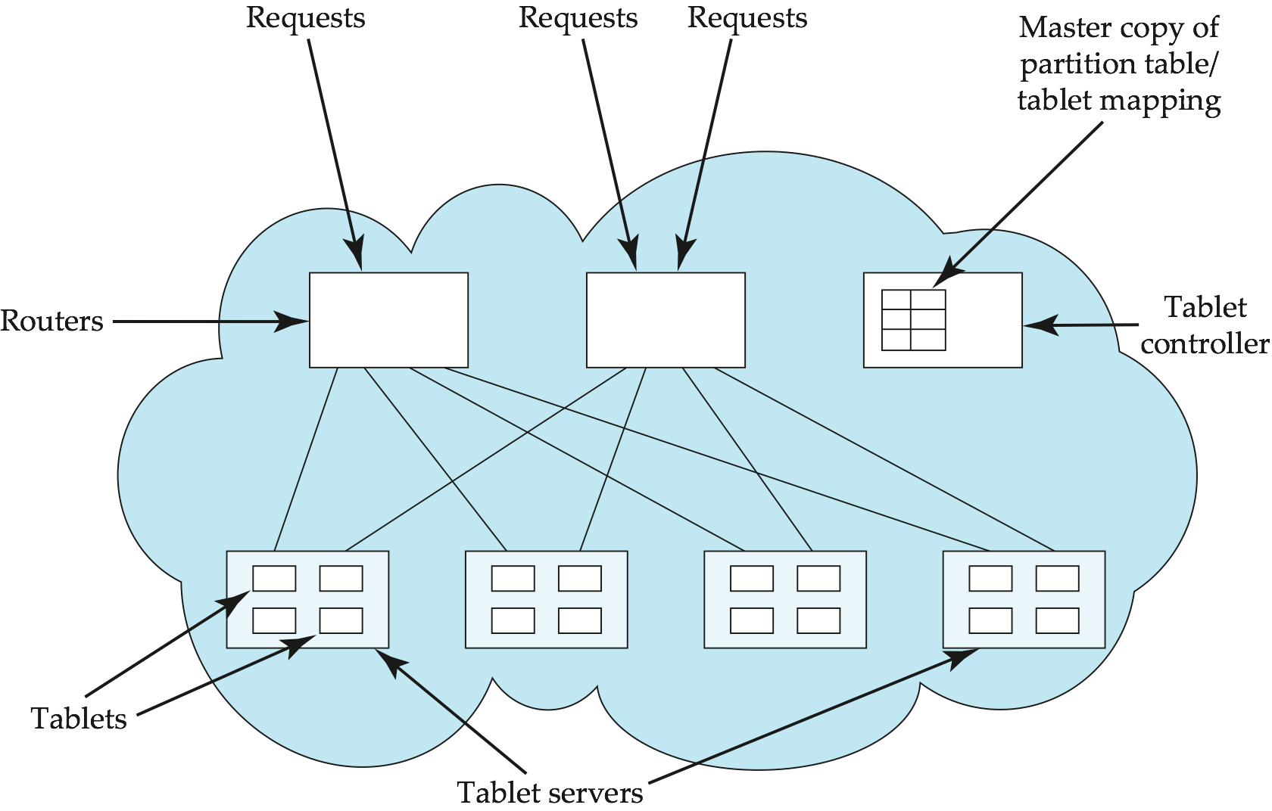
PNUTS Parallel Storage System Architecture

Slide 101
Distributed Directory Systems

Slide 102
Directory Systems
Typical kinds of directory information
  Employee information such as name, id, email, phone, office addr, ..
  Even personal information to be accessed from multiple places
    e.g. Web browser bookmarks
White pages
  Entries organized by name or identifier
    Meant for forward lookup to find more about an entry
Yellow pages
  Entries organized by properties
  For reverse lookup to find entries matching specific requirements
When directories are to be accessed across an organization
  Alternative 1: Web interface. Not great for programs
  Alternative 2: Specialized directory access protocols
    Coupled with specialized user interfaces

Slide 103
Directory Access Protocols
Most commonly used directory access protocol:
  LDAP (Lightweight Directory Access Protocol)
  Simplified from earlier X.500 protocol
Question: Why not use database protocols like ODBC/JDBC?
Answer:
  Simplified protocols for a limited type of data access, evolved parallel to ODBC/JDBC
  Provide a nice hierarchical naming mechanism similar to file system directories
    Data can be partitioned amongst multiple servers for different parts of the hierarchy, yet give a single view to user
      E.g. different servers for Bell Labs Murray Hill and Bell Labs Bangalore
  Directories may use databases as storage mechanism

Slide 104
LDAP: Lightweight Directory Access Protocol
LDAP Data Model
Data Manipulation
Distributed Directory Trees

Slide 105
LDAP Data Model
LDAP directories store entries
  Entries are similar to objects
Each entry must have unique distinguished name (DN)
DN made up of a sequence of relative distinguished names (RDNs)
E.g. of a DN
  cn=Silberschatz, ou-Bell Labs, o=Lucent, c=USA
  Standard RDNs (can be specified as part of schema)
    cn: common name ou: organizational unit
    o: organization c: country
  Similar to paths in a file system but written in reverse direction

Slide 106
LDAP Data Model (Cont.)
Entries can have attributes
  Attributes are multi-valued by default
  LDAP has several built-in types
    Binary, string, time types
    Tel: telephone number PostalAddress: postal address
LDAP allows definition of object classes
  Object classes specify attribute names and types
  Can use inheritance to define object classes
  Entry can be specified to be of one or more object classes
    No need to have single most-specific type

Slide 107
LDAP Data Model (cont.)
Entries organized into a directory information tree according to their DNs
  Leaf level usually represent specific objects
  Internal node entries represent objects such as organizational units, organizations or countries
  Children of a node inherit the DN of the parent, and add on RDNs
    E.g. internal node with DN c=USA
      Children nodes have DN starting with c=USA and further RDNs such as o or ou
    DN of an entry can be generated by traversing path from root
  Leaf level can be an alias pointing to another entry
    Entries can thus have more than one DN
      E.g. person in more than one organizational unit

Slide 108
LDAP Data Manipulation
Unlike SQL, LDAP does not define DDL or DML
Instead, it defines a network protocol for DDL and DML
  Users use an API or vendor specific front ends
  LDAP also defines a file format
    LDAP Data Interchange Format (LDIF)
Querying mechanism is very simple: only selection & projection

Slide 109
LDAP Queries
LDAP query must specify
  Base: a node in the DIT from where search is to start
  A search condition
    Boolean combination of conditions on attributes of entries
      Equality, wild-cards and approximate equality supported
  A scope
    Just the base, the base and its children, or the entire subtree from the base
  Attributes to be returned
  Limits on number of results and on resource consumption
  May also specify whether to automatically dereference aliases
LDAP URLs are one way of specifying query
LDAP API is another alternative

Slide 110
LDAP URLs
First part of URL specifis server and DN of base
  ldap:://aura.research.bell-labs.com/o=Lucent,c=USA
Optional further parts separated by ? symbol
  ldap:://aura.research.bell-labs.com/o=Lucent,c=USA??sub?cn=Korth
  Optional parts specify
    attributes to return (empty means all)
    Scope (sub indicates entire subtree)
    Search condition (cn=Korth)

Slide 111
C Code using LDAP API
#include <stdio.h>
#include <ldap.h>
main( ) {
LDAP *ld;
LDAPMessage *res, *entry;
char *dn, *attr, *attrList [ ] = {“telephoneNumber”, NULL};
BerElement *ptr;
int vals, i;
// Open a connection to server
ld = ldap_open(“aura.research.bell-labs.com”, LDAP_PORT);
ldap_simple_bind(ld, “avi”, “avi-passwd”);
… actual query (next slide) …
ldap_unbind(ld);
}

Slide 112
C Code using LDAP API (Cont.)
ldap_search_s(ld, “o=Lucent, c=USA”, LDAP_SCOPE_SUBTREE,
“cn=Korth”, attrList, /* attrsonly*/ 0, &res);
/*attrsonly = 1 => return only schema not actual results*/ printf(“found%d entries”, ldap_count_entries(ld, res));
for (entry=ldap_first_entry(ld, res); entry != NULL; entry=ldap_next_entry(id, entry)) {
dn = ldap_get_dn(ld, entry);
printf(“dn: %s”, dn); /* dn: DN of matching entry */
ldap_memfree(dn);
for(attr = ldap_first_attribute(ld, entry, &ptr); attr != NULL;
attr = ldap_next_attribute(ld, entry, ptr))
{ // for each attribute
printf(“%s:”, attr); // print name of attribute
vals = ldap_get_values(ld, entry, attr);
for (i = 0; vals[i] != NULL; i ++)
printf(“%s”, vals[i]); // since attrs can be multivalued
ldap_value_free(vals);
}
}
ldap_msgfree(res);

Slide 113
LDAP API (Cont.)
LDAP API also has functions to create, update and delete entries
Each function call behaves as a separate transaction
  LDAP does not support atomicity of updates

Slide 114
Distributed Directory Trees
Organizational information may be split into multiple directory information trees
  Suffix of a DIT gives RDN to be tagged onto to all entries to get an overall DN
    E.g. two DITs, one with suffix o=Lucent, c=USA
    and another with suffix o=Lucent, c=India
  Organizations often split up DITs based on geographical location or by organizational structure
  Many LDAP implementations support replication (master-slave or multi-master replication) of DITs (not part of LDAP 3 standard)
A node in a DIT may be a referral to a node in another DIT
  E.g. Ou= Bell Labs may have a separate DIT, and DIT for o=Lucent may have a leaf with ou=Bell Labs containing a referral to the Bell Labs DIT
  Referalls are the key to integrating a distributed collection of directories
  When a server gets a query reaching a referral node, it may either
    Forward query to referred DIT and return answer to client, or
    Give referral back to client, which transparently sends query to referred DIT (without user intervention)

Slide 115
End of Chapter

Slide 116
Extra Slides on 3PC

Slide 117
Three Phase Commit (3PC)
Assumptions:
  No network partitioning
  At any point, at least one site must be up.
  At most K sites (participants as well as coordinator) can fail
Phase 1: Obtaining Preliminary Decision: Identical to 2PC Phase 1.
  Every site is ready to commit if instructed to do so
Phase 2 of 2PC is split into 2 phases, Phase 2 and Phase 3 of 3PC
  In phase 2 coordinator makes a decision as in 2PC (called the pre-commit decision) and records it in multiple (at least K) sites
  In phase 3, coordinator sends commit/abort message to all participating sites,
Under 3PC, knowledge of pre-commit decision can be used to commit despite coordinator failure
  Avoids blocking problem as long as < K sites fail
Drawbacks:
  higher overheads
  assumptions may not be satisfied in practice

Slide 118
Three Phase Commit (3PC)
Assumptions:
  No network partitioning
  At any point, at least one site must be up.
  At most K sites (participants as well as coordinator) can fail
Phase 1: Obtaining Preliminary Decision: Identical to 2PC Phase 1.
  Every site is ready to commit if instructed to do so
  Under 2 PC each site is obligated to wait for decision from coordinator
  Under 3PC, knowledge of pre-commit decision can be used to commit despite coordinator failure.

Slide 119
3PC: Phase 2. Recording the Preliminary Decision
Coordinator adds a decision record (<abort T> or
< precommit T>) in its log and forces record to stable storage.
Coordinator sends a message to each participant informing it of the decision
Participant records decision in its log
If abort decision reached then participant aborts locally
If pre-commit decision reached then participant replies with <acknowledge T>

Slide 120
3PC: Phase 3. Recording Decision in the Database
Executed only if decision in phase 2 was to precommit
Coordinator collects acknowledgements. It sends <commit T> message to the participants as soon as it receives K acknowledgements.
Coordinator adds the record <commit T> in its log and forces record to stable storage.
Coordinator sends a message to each participant to <commit T>
Participants take appropriate action locally

Slide 121
3PC: Handling Site Failure
Site Failure. Upon recovery, a participating site examines its log and does the following:
  Log contains <commit T> record: no action
  Log contains <abort T> record: no action
  Log contains <ready T> record, but no <abort T> or <precommit T> record: site consults Ci to determine the fate of T.
    if Ci says T aborted, site executes undo (T) (and writes
    <abort T> record)
    if Ci says T committed, site executes redo (T) (and writes
    < commit T> record)
    if c says T committed, site resumes the protocol from receipt of precommit T message (thus recording <precommit T> in the log, and sending acknowledge T message sent to coordinator).

Slide 122
3PC: Handling Site Failure (Cont.)
Log contains <precommit T> record, but no <abort T> or <commit T>: site consults Ci to determine the fate of T.
  if Ci says T aborted, site executes undo (T)
  if Ci says T committed, site executes redo (T)
  if Ci says T still in precommit state, site resumes protocol at this point
Log contains no <ready T> record for a transaction T: site executes undo (T) writes <abort T> record

Slide 123
Figure 19.02

Slide 124
Figure 19.03

Slide 125
Figure 19.04

Slide 126
Figure 19.05

Slide 127
Figure 19.06

Slide 128
Figure 19.07

